Slide 1
Decryption
Shashank shivhare
CSCi- 174

Slide 2
Problem Defining
Given an encrypted message and a key.
Message : "012222 1114142503 0313012513 03141418192102 0113 2419182119021713 06131715070119“
Key: "BHISOECRTMGWYVALUZDNFJKPQX“
----→>>> Decryption is required

Slide 3
Initial Process
Assign Key numbers from 0
Divide the message in set of two
Give A-Z 0 to 25

Slide 4
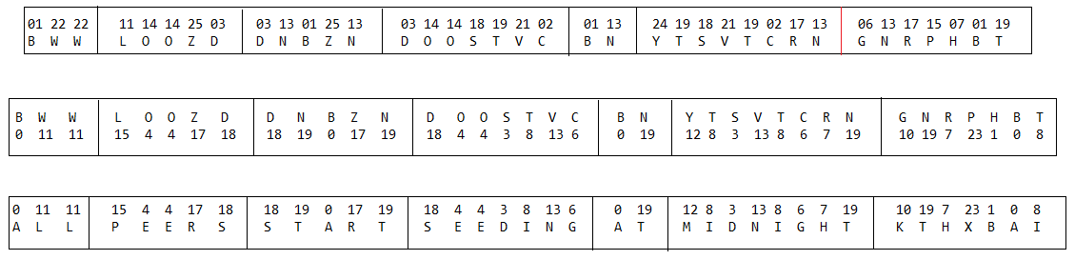
aLGORithm

Slide 5
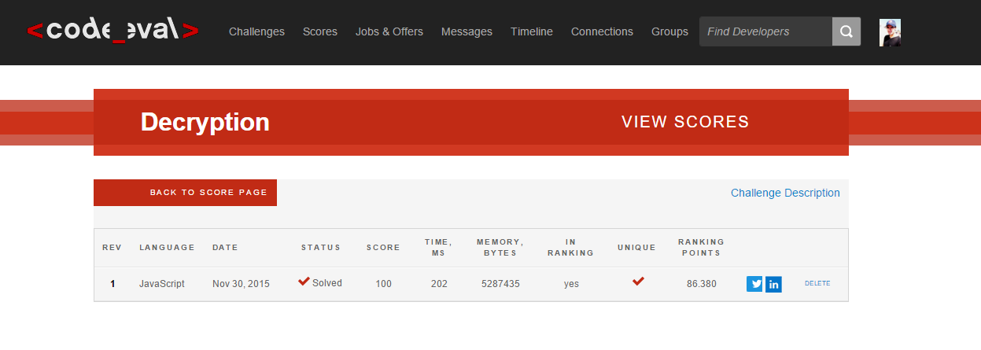
Code eval Point

Slide 6
Code

